Slide 1


Human Trafficking Data Analysis
Project 1:
Elizabeth Harrison
Lisa Jemmings
Shirley Limburg
Saron Raut
Mara Schemel
Sumit Patel

Slide 2
Fight the Plague of Human Trafficking
USA Human Trafficking Statistics 2.7 per 100k – 11,500 human trafficking cases reported in 2019 https://worldpopulationreview.com/state-rankings/human-trafficking-statistics-by-state
Worldwide, an estimated 20.8 million people are victims of human trafficking, contributing to an industry that generates more than $150 billion in illegal profits. https://www.dhs.gov/sites/default/files/publications/4146_CombattingHumanTraffickingThroughSocialScience.pdf
How do people become trafficked?
What industries people most likely to be trafficked in?
Where does it happen the most?
How does wealth factor into the likelihood of being trafficked?
Questions you found interesting and what motivated you to answer them - Sumit

Slide 3
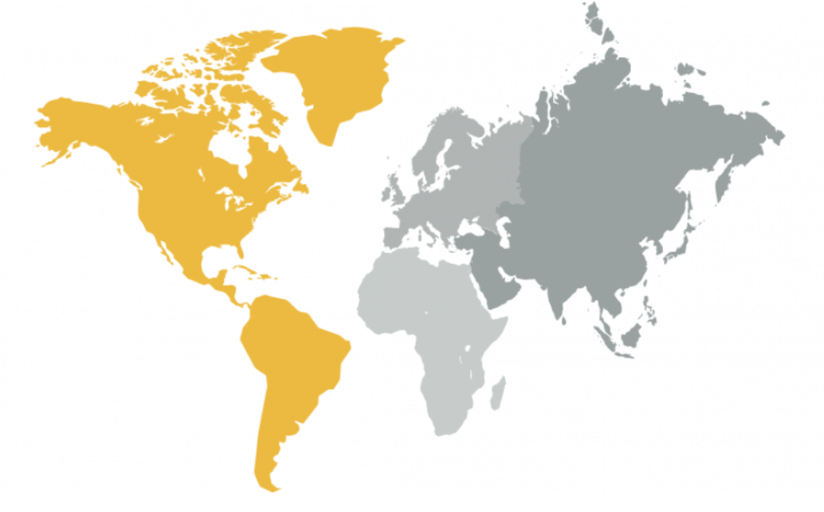
Counter Trafficking Data Collaborative and World Bank
•Main Source : CTDC
•First global data hub on human trafficking
•Data contributed from organization around the world
Where and how you found the data you used to answer these questions - Saron

Slide 4
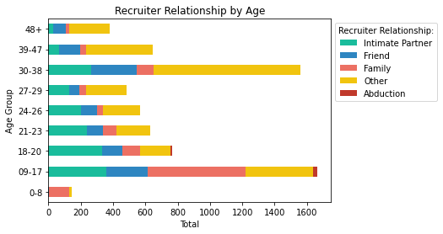
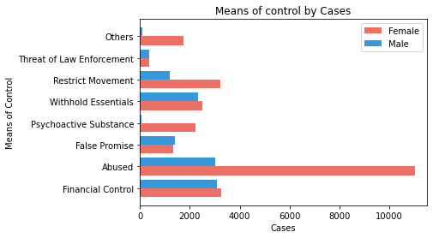
How Trafficking Starts
How Victims Are Controlled
Notes:
Intimate Partner 1624
Friend 1129
Family 1163
Other 2886
Abduction 39
Recruiter Correlation with age:
· Intimate Partner: The highest counts of cases that had Intimate Partner as their recruiter relationship was between age 9-17 with 357. Following close is 18-20 with 335 Cases. Lowest is for age 48+ with only 30 cases reporting as recruiter being an intimate partner.
o Take away: Teens and young adults had higher numbers of cases with the recruiter being their intimate partner.
· Friends: Age group 9-17 with 256 cases and age group 39-47 with 279 cases with recruiter relationship being their friend.
· Family: highest cases are seen for ages group 9-17 with 605 cases that Family as the form of recruitment. The Cases slowly drop until age 30-38 where we see a spike of 107 cases.
· Other form of relationship is the highest form or recruitment relationship with 2886 cases regardless of age. Other form of relationship can be categorized as relationship that do not fall under the other category. Could also mean that there is no type of relationship between the victim and the recruiter.
· Abduction: Out of 39 cases reported in the whole data, 26 of the cases belong to the age group 9-17.
· ***Main Point: More cases are reported for age groups 09-17 and 30-38. The correlation between these group could depend on the type of exploitation they are being trafficked for.
· **another take-away: Other form of relationship is more predominant in cases when looking at recruiter relationship. Could also mean that there is no type of relationship between the victim and the recruiter. Second being Intimate Partner with 1624 cases.
· **Detail on report** : We dropped data that missing information for recruiter relationship
Means of Control by Cases:
· Due to many Forms of Control, we categorized the means of control that would be easier to display on graphs.
o Groups of Means of Control:
§ Abused included: Physical, Psychological, Sexual, and Threats
§ Financial includes: Debt Bondage, Restrict Financial Access, Excessive Working hours, Earning Control
§ Withhold Essentials includes: Withhold documents, Necessities, restrict Medical Care, Control using Children.
· Just looking at the data, majority of the females in the case were control through Abuse, with 11020 cases reported compared to 3023 cases for men.
· According to the data highest form of control for male was Financial Control with 3086 cases. The lowest form of control reported was Psychoactive Substance with only 58 cases.
· Means of control for Financial Control, False Promise, Withhold Essentials, and Threat of Law enforcement are roughly around the same range.
· Other form of Means of Control could be that they do not fall under any of the specified category. Other doesn’t mean it’s unknown.
· **Detail on report** : We dropped data that missing information for recruiter relationship

Slide 5
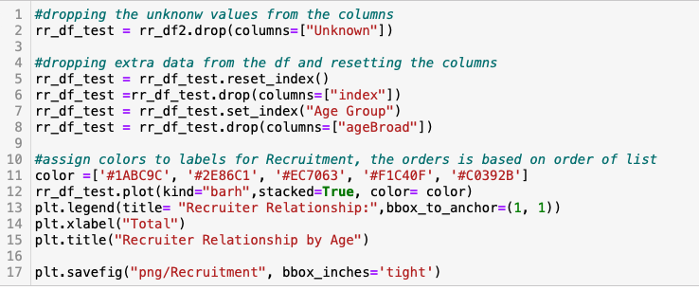
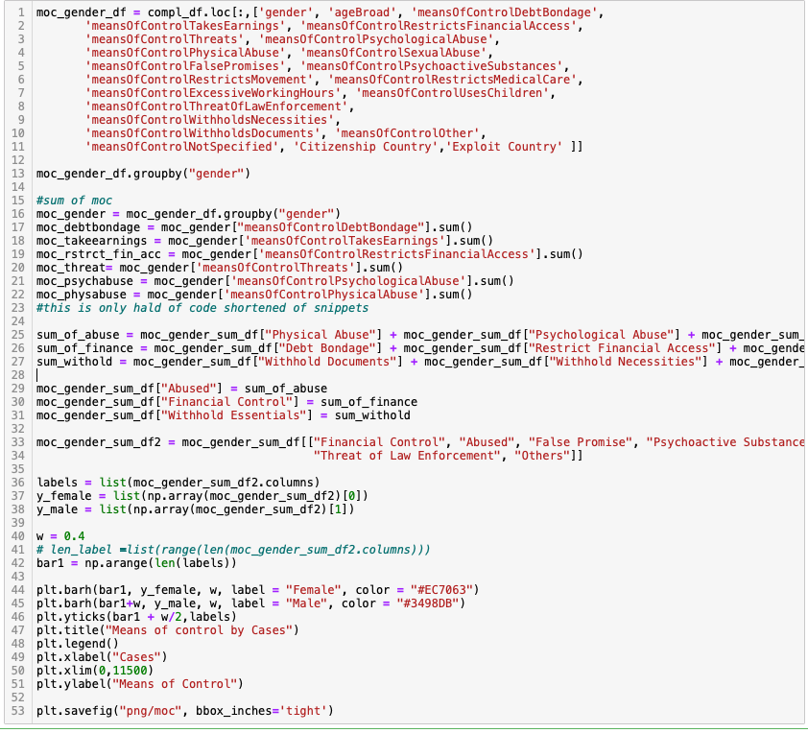
Code snippet : RR and MoC codes
Recruitment Relationship Plot Code
Means of Control Plot Code
Notes:
Approach for RR data:
• Taking the pre cleaned Data and dropping unknown values.
•Data was grouped by Age Broad.
•Creating a data frame using pd.DataFrame
•Reset and drop index and set the index to be Age group (this column was added due to index not sorting
•Use panda built in plot function to plot a horizontal bar graph
•Added the details such as colors, legend, labels and titles
Approach for Moc:
•Using loc function create a df focusing on certain columns
•Grouping by gender since the focus is to compare between genders
•Get the sum of of the control columns
•Group the control by category that represent the type.
•Create df from all the saved variables
•Plot using matplotlib bar
•Numpy to get the length of labels and to help separate out the bars or else it would be plotted as stacked bar.

Slide 6
Data Integrity Could be Improved
Dataframe showing unknowns
Country names were not identical between datasets. For GDP the .csv source file was edited to make country names match to merge data
Another example
Venn diagram of world wide estimates vs reported cases
The data exploration and cleanup process (accompanied by your Jupyter Notebook) -Mara

Slide 7
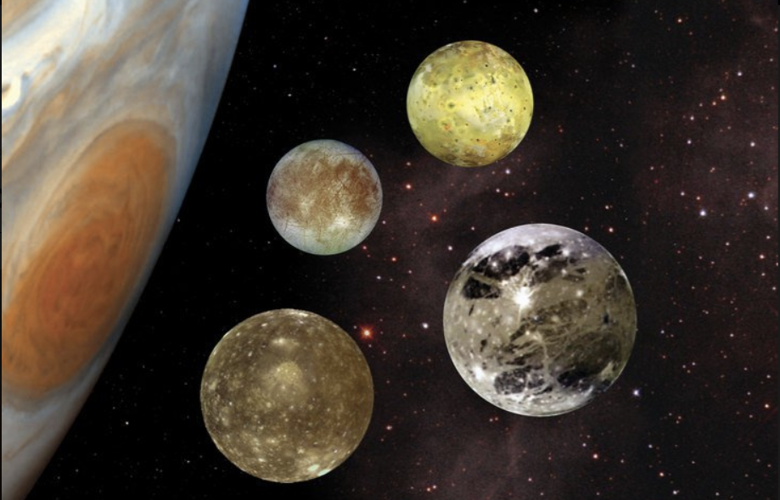
The Approach
Jupyter Notebook excerpts
The analysis process (accompanied by your Jupyter Notebook) - Liz

Slide 8
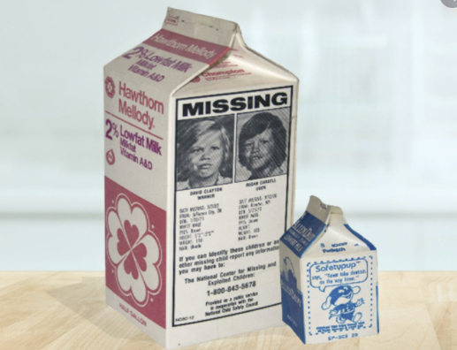
What We Found
Ages trafficked
graph
Industries graph
Your conclusions, which should include a numerical summary and visualizations of that summary - Lisa

Slide 9
Conclusion
Your conclusions, which should include a numerical summary and visualizations of that summary -Lisa_

Slide 10
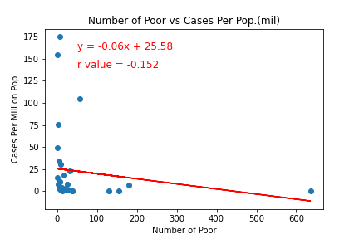
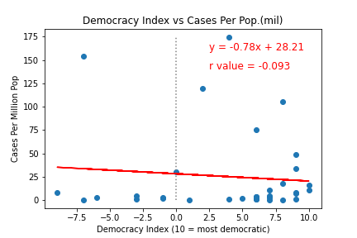
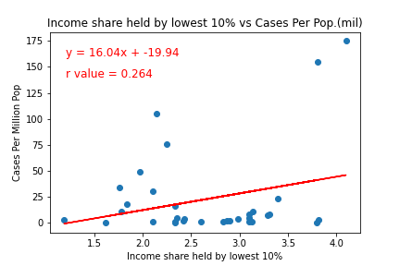
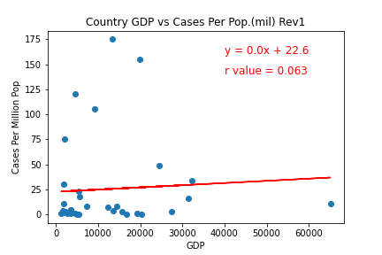

Humans Trafficking Can Happen Anywhere in the World
Very Poor /No Correlation between Economic Factors Across Countries of Origin & Cases

Slide 11
We May Never Completely Know the True Extent of Human Trafficking
“Human trafficking is a heinous crime happening all around us. The victims—30% of which are children—are subject to forced labour, sexual exploitation and other forms of abuse. We must do more to bring criminals to justice, and help victims rebuild their lives. “ António Guterres
Secretary General of the United Nations
Need help? United States:
1 (888) 373-7888
National Human Trafficking Hotline
SMS: 233733 (Text "HELP" or "INFO")
Hours: 24 hours, 7 days a week
Languages: English, Spanish and 200 more languages
Website: humantraffickinghotline.org
The implications of your findings: what do your findings mean? - SHirley

Slide 12
Appendix:

Slide 13
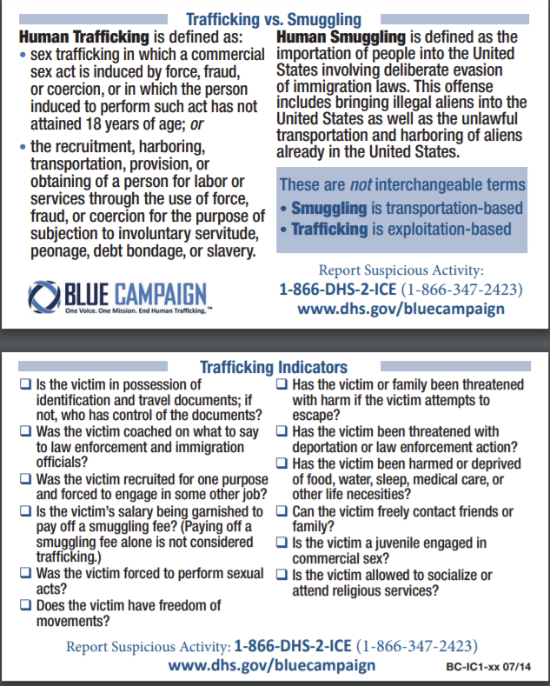
US Department of Homeland Security
https://www.dhs.gov/sites/default/files/publications/20_0115_plcy_human-trafficking-forced-labor-child-exploit-strategy.pdf

